Slide 1

Programming in Java
Lecture 11: ArrayList

Slide 2
Introduction
Standard Java arrays are of a fixed length.
After arrays are created, they cannot grow or shrink, which means we can not resize Arrays.
Arrays are useful when we know in advance how many elements the array is to hold.
ArrayList is a collection which provides the implementation of resizable array.

Slide 3
ArrayList
The ArrayList class extends AbstractList and implements the List interface.
Defined in java.util package.
ArrayList supports dynamic arrays that can grow as needed.
Array lists are created with an initial size.
When this size is exceeded, the collection is automatically enlarged.
When objects are removed, the array may be shrunk.

Slide 4
ArrayList Constructors
The ArrayList class supports three constructors.
ArrayList() : creates an empty array list with an initial capacity sufficient to hold 10 elements.
ArrayList(int capacity) : creates an array list that has the specified initial capacity.
ArrayList(Collection c) : creates an array list that is initialized with the elements of the collection c.

Slide 5
Methods of ArrayList
boolean add(Object o)
Appends the specified element to the end of this list.
void add(int index, Object element)
Inserts the specified element at the specified position index in this list.
Throws IndexOutOfBoundsException if the specified index is is out of range.

Slide 6
boolean addAll(Collection c )
Appends all of the elements in the specified collection to the end of this list.
Throws NullPointerException if the specified collection is null.
boolean addAll(int index, Collection c )
Inserts all of the elements of the specified collection into this list, starting at the specified position.
Throws NullPointerException if the specified collection is null.

Slide 7
void clear()
Removes all of the elements from this list.
Object remove(int index)
Removes the element at the specified position in this list.
Object clone()
Returns a shallow copy of this ArrayList.
int size()
Returns the number of elements in the list.

Slide 8
boolean contains(Object o)
Returns true if this list contains the specified element.
Object get(int index)
Returns the element at the specified position in this list.
int indexOf(Object o)
Returns the index in this list of the first occurrence of the specified element, or -1 if the List does not contain the element.
int lastIndexOf(Object o)
Returns the index in this list of the last occurrence of the specified element, or -1.

Slide 9
void ensureCapacity(int minCapacity)
Increases the capacity of this ArrayList instance, if necessary, to ensure that it can hold at least the number of elements specified by the minimum capacity argument.
Object set(int index, Object element)
Replaces the element at the specified position in this list with the specified element.
Throws IndexOutOfBoundsException if the specified index is out of range (index < 0 || index >= size()).

Slide 10
boolean isEmpty()
used to check whether the Arraylist is empty or not?
void trimToSize()
reduces the size of an arraylist to the number of elements present in the arraylist.

Slide 11
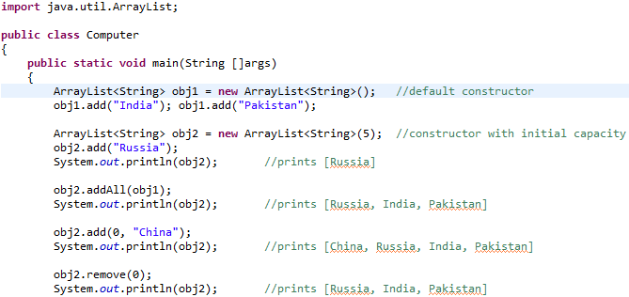
Example

Slide 12
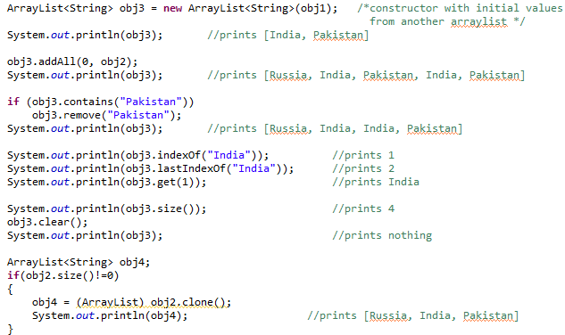
Example

Slide 13
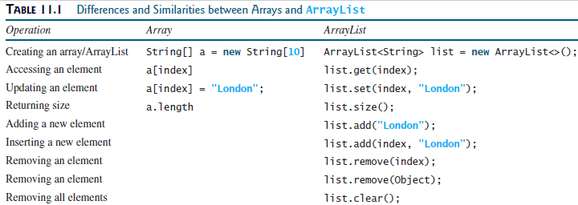
Array vs. ArrayList

Slide 14
Exercise 1
add some String objects (including duplicates) in ArrayList.
(Eg.: "India", "China", "Pakistan", "Sri-Lanka", "China", "Pakistan")
add "South Africa" at 2nd position in list
verify the duplicacy of "China" if it exists in list. (using indexOf/lastIndexOf method)
if "Pakistan" is there in the list, then remove all its instances.
make new ArrayList with objects scanned by the user.
add all elements of previous ArrayList into this new list.
print the size of the new list.
make a duplicate ArrayList from this new list (if its size>0) using clone() method.
Empty the ArrayList created at the last.

Slide 15
Exercise 2
Write a program to store the Employee objects in an arraylist such that each employee is having name, emp_id and salary attributes.
Implement a method getEmployee(String name) and display the emp_id and salary of that Employee.

Slide 16
Exercise 3
Write a program to define a class named Employee with attributes: name, salary and id. Also provide a parameterized constructor to initialize all the attributes. Create a class TestEmployee in which create “n” employee objects and store in an arraylist.
Implement a method public void search(int id) which display the name and salary of the employee with given id.

Slide 17
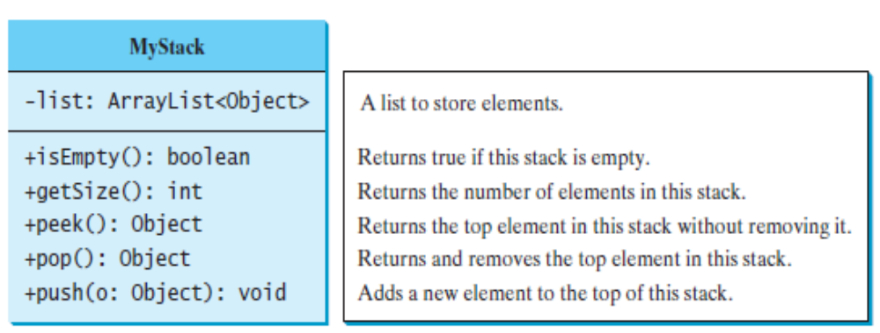
Exercise 4
Create a custom Stack class using ArrayList which is as follows:

Slide 18


